Slide 3
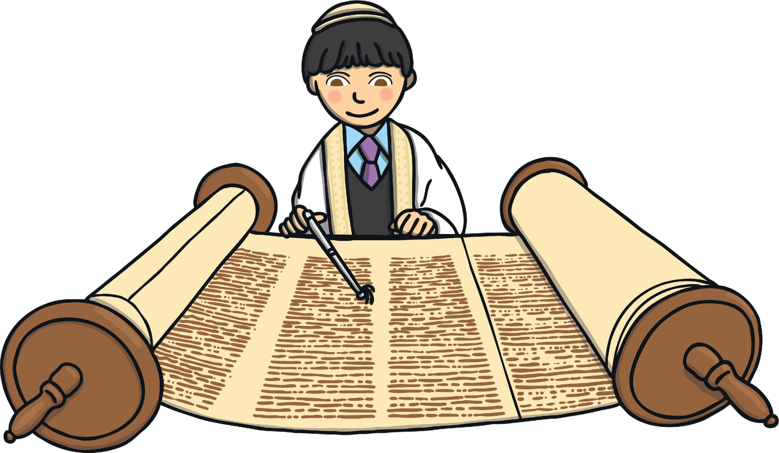
What Is the Torah?
The Torah is the most important and holy text in Judaism.

Slide 4
What Is the Torah?
The word Torah comes from an old Hebrew word meaning ‘to teach’.
Jewish people believe that the Torah contains instructions from God on how to live a good life.

Slide 5
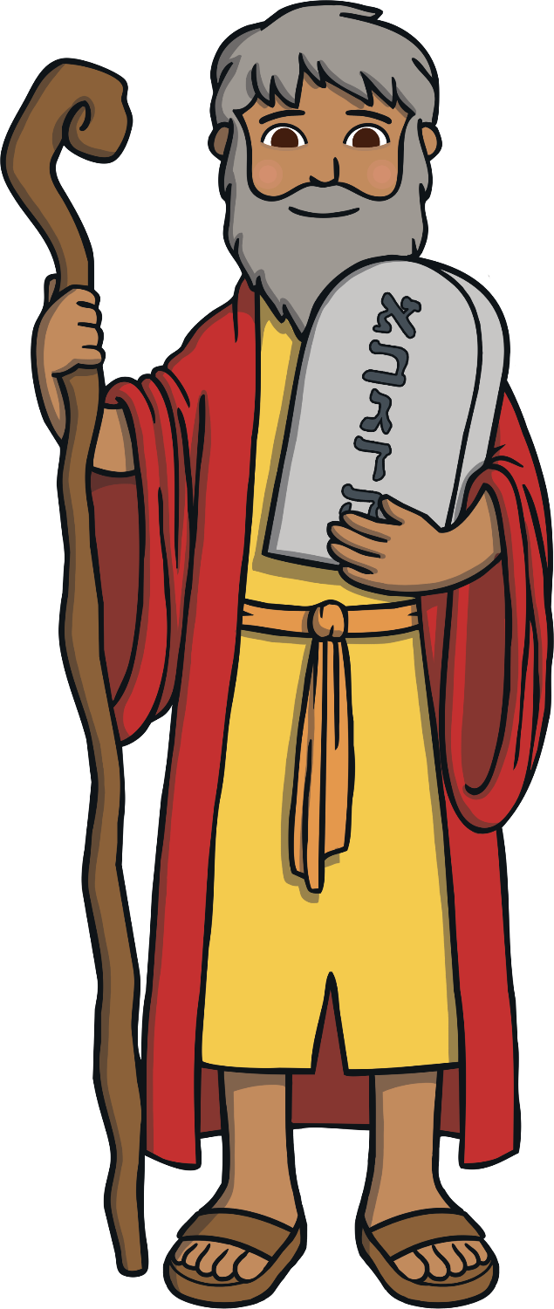
Moses
Did You Know…?
A prophet is somebody who passes on the word of God like a messenger.
Jewish people believe that the laws written down in the Torah were given by God. They believe that a prophet called Moses received the laws thousands of years ago.

Slide 6
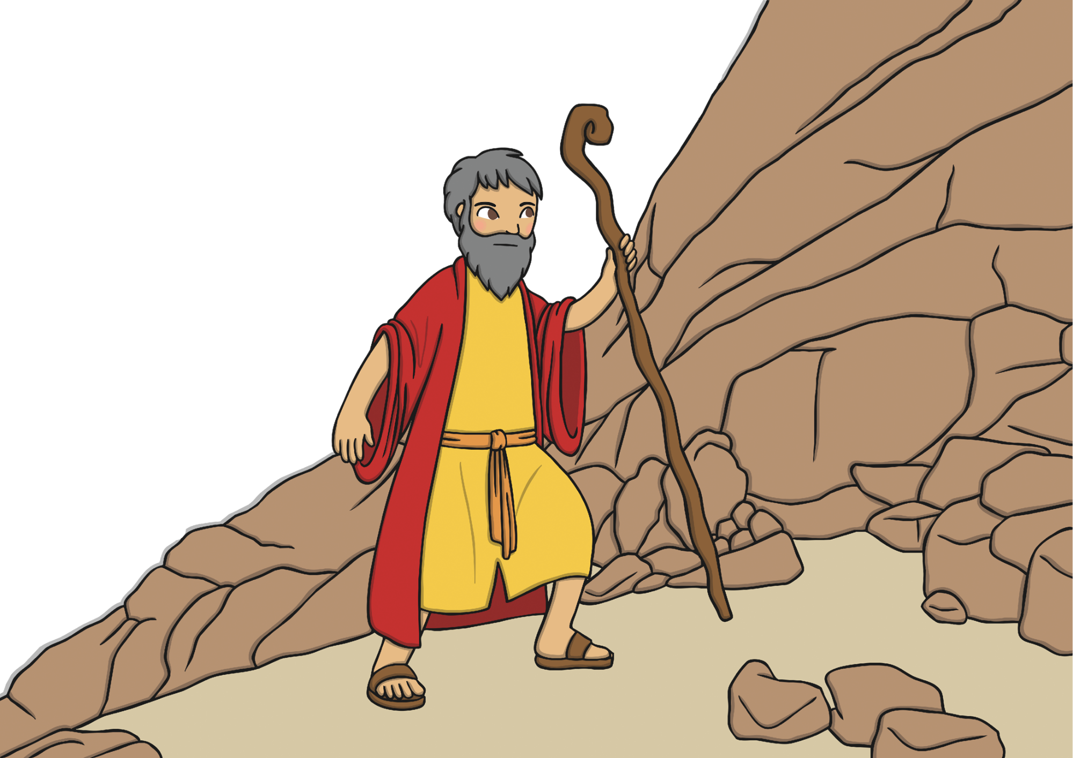
The Ten Commandments
God asked Moses to climb to the top of a Mountain called Mount Sinai.
He gave Moses a set of ten special laws that people should follow in order to live a good life and please God.

Slide 7
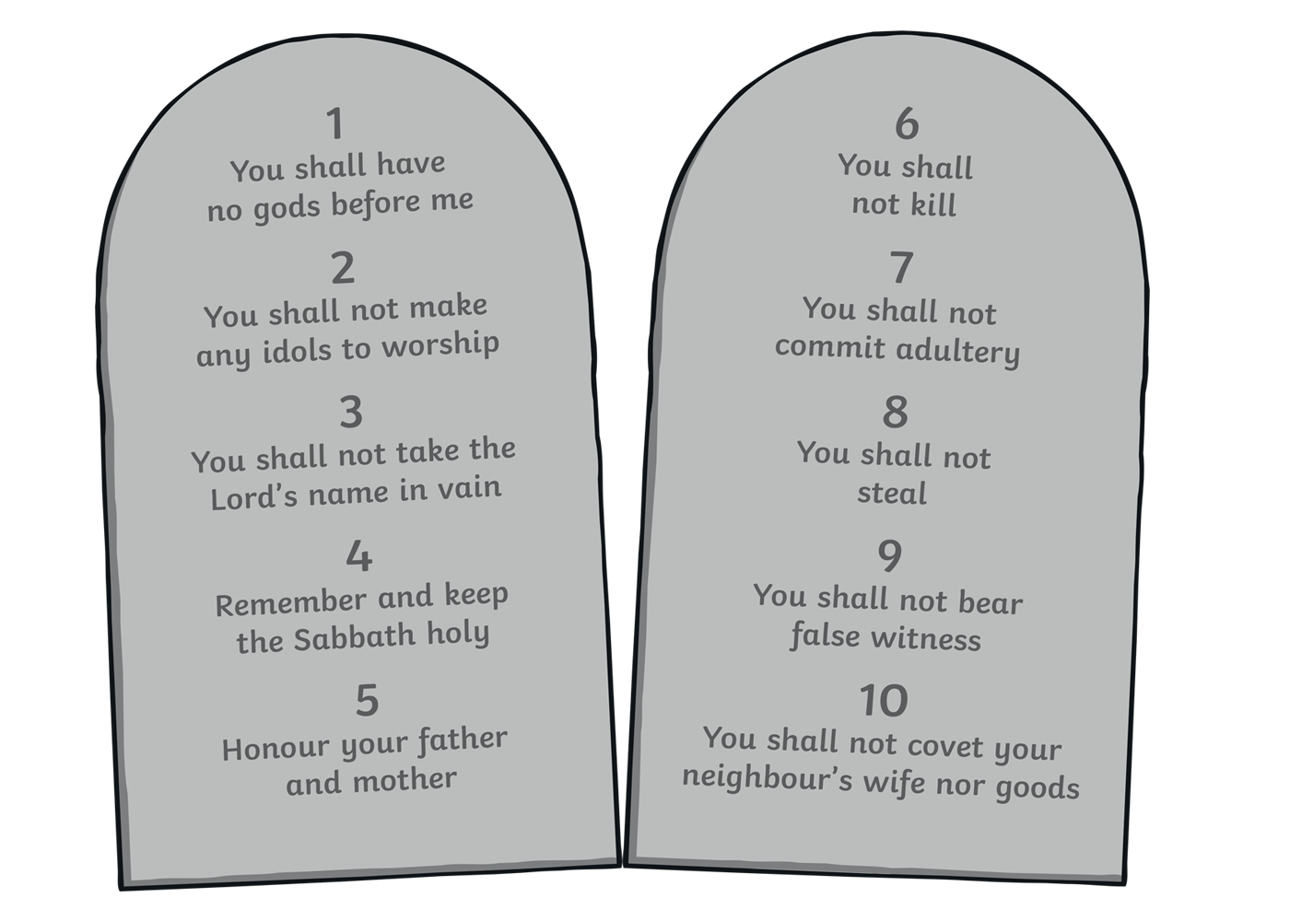
The Ten Commandments
These ten laws were written in stone and God asked Moses to teach them to all of the Jewish people.

Slide 8
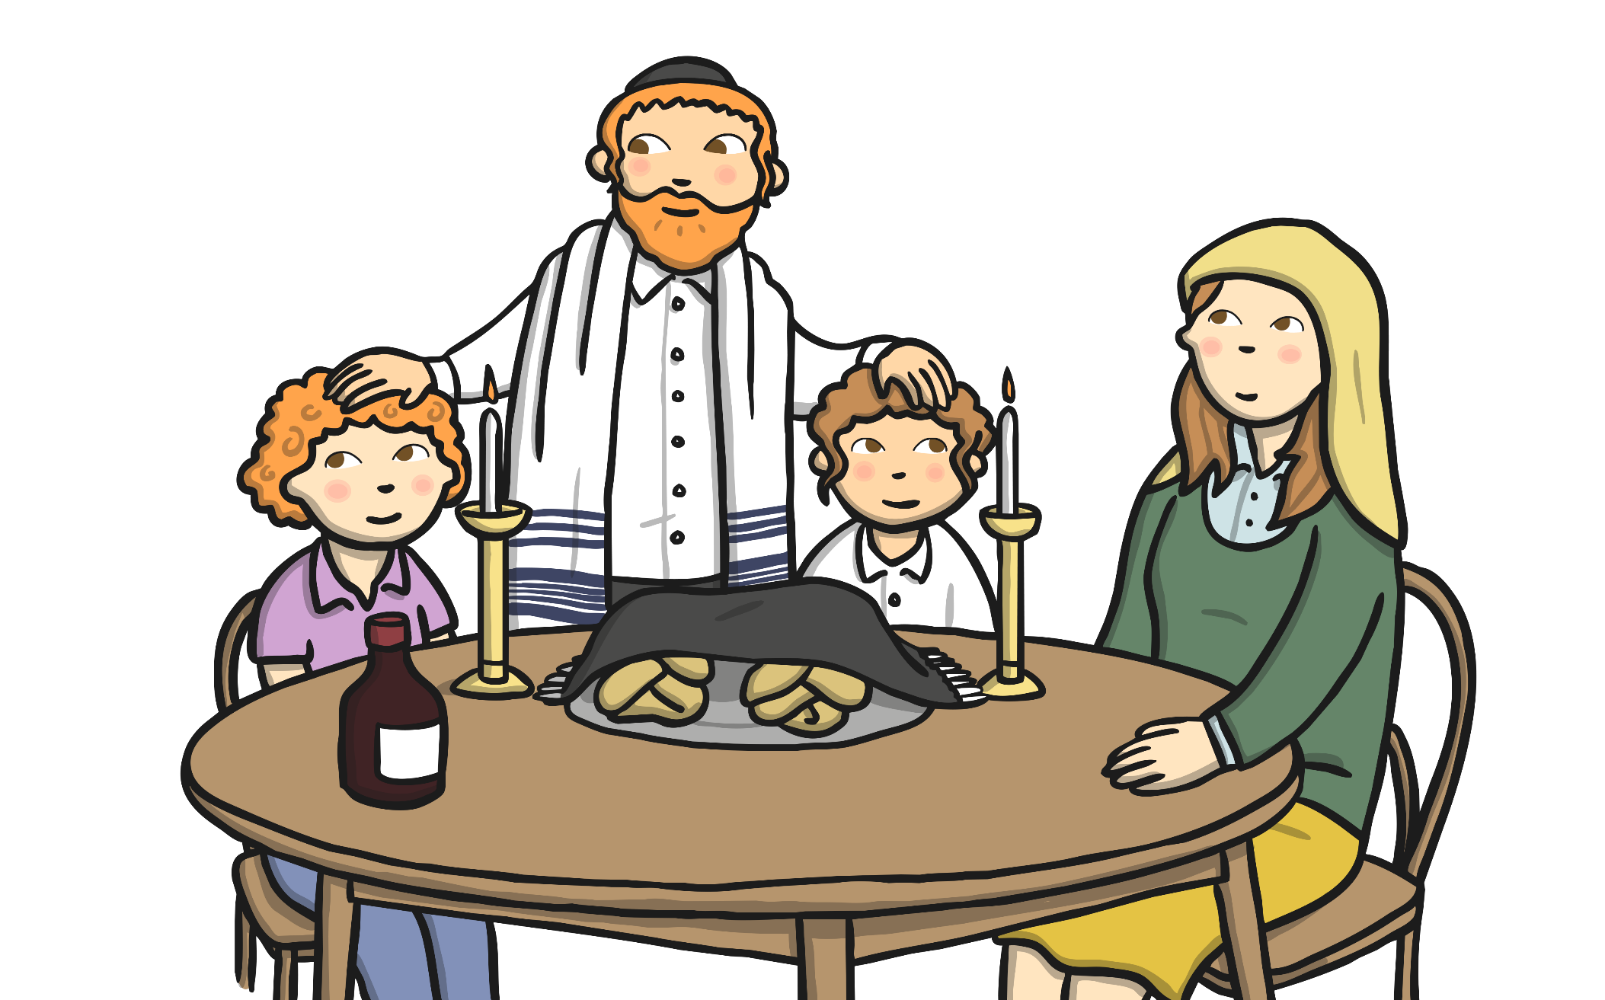
The Torah
The Torah is very special to Jewish people as it includes all of the instructions that God gave to Moses. Jewish people today use the Torah to help guide them in their lives.

Slide 9
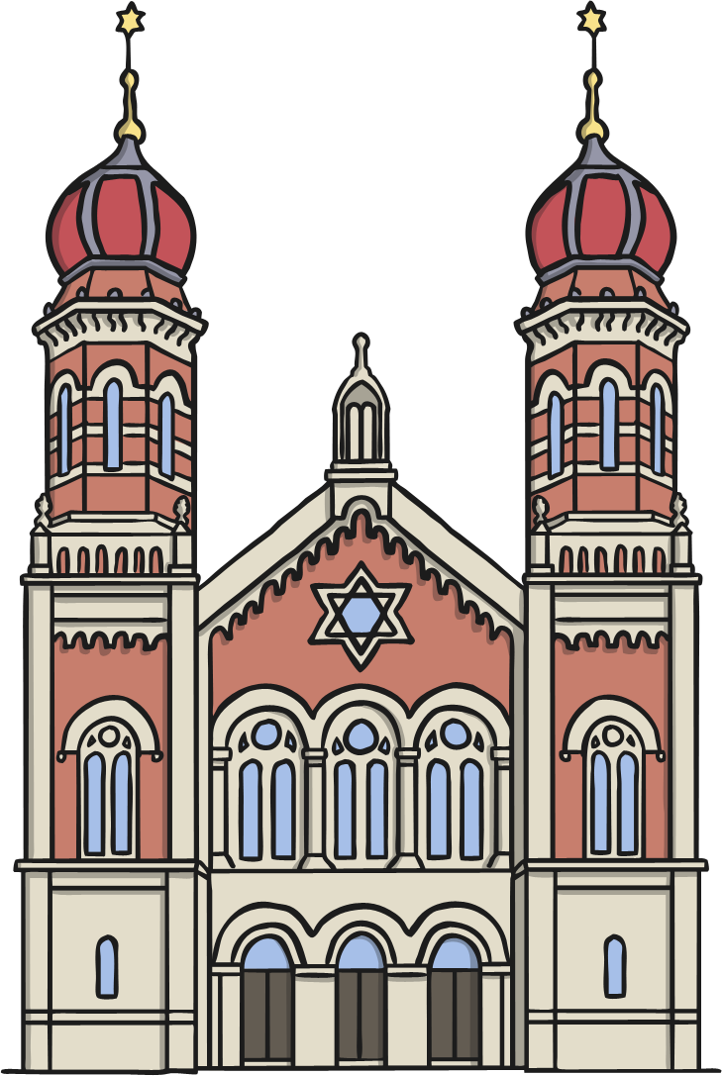
The Sefer Torah
Every synagogue (Jewish holy building) has a Sefer Torah.
This is a Torah written out by a specially trained scribe onto a special scroll.

Slide 10

The Sefer Torah
The Sefer Torah is treated with great respect. It is not allowed to be touched by human hands.
When it is being read, a special stick called a yad is used to point to the words.

Slide 11

The Importance of the Torah
The Torah is read in the synagogue every week. It is a very great honour to be asked to read from the Torah.
Did You Know…?
There are 304,805 letters in a Torah scroll and it takes around a year to write!

Slide 12
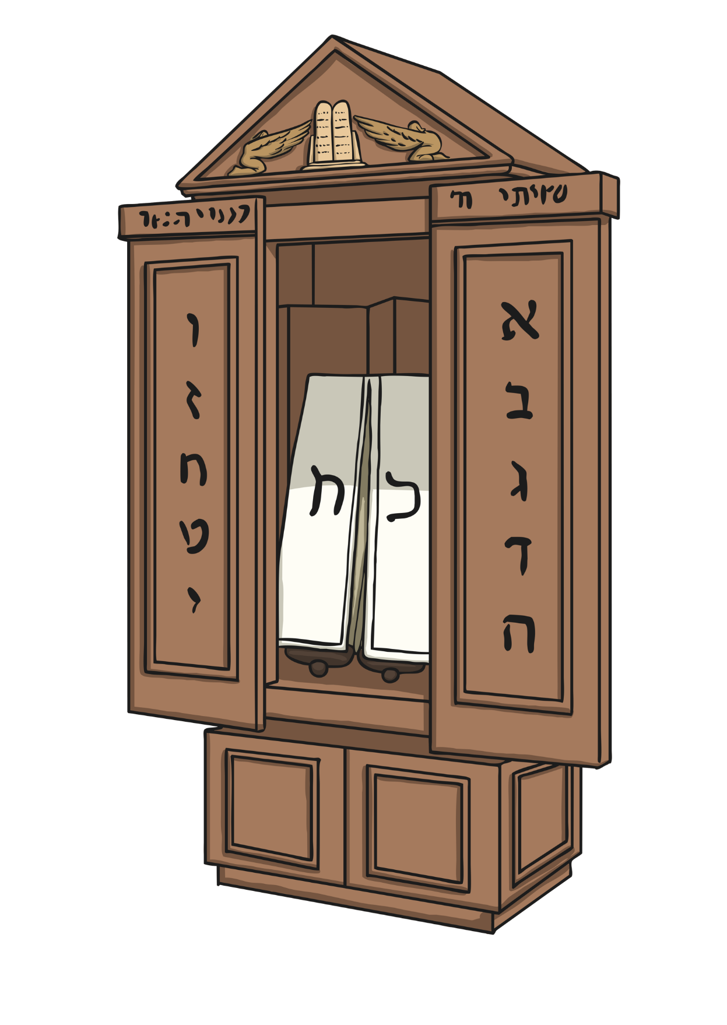

The Ark
When the Torah is not being read, it is kept in a special cupboard at the front of the synagogue. This cupboard is called an ark.

Slide 13
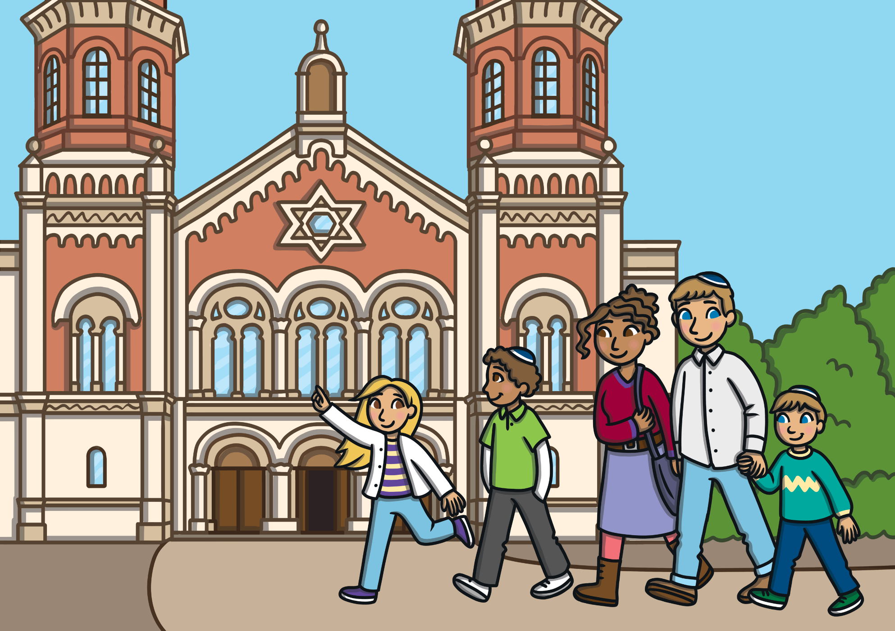
Shavuot
Shavuot is a Jewish festival held in late Spring when Jewish people remember Moses receiving God’s instructions on Mount Sinai.
At this special time, Jewish people will listen to readings from the Torah, attend synagogues and gather with their families.
Synagogues are decorated with flowers and plants.

