Slide 1
blood vessels
Blood vessels are tubes through which blood flows around the body.
circulatory system
The circulatory system is a network of the heart,
blood and blood vessels working together to circulate blood around the body.
heart
The heart is an organ that pumps blood around the body.
flowchart
A flowchart is a diagram that shows the steps of a process from beginning to end.
draft
A draft is a detailed outline that provides the information you need to complete a task.

Slide 2


The circulatory system
Our body is made up of different systems all
working together to keep us alive.
I think the body is a system like a computer with lots of moving switches and wires.
What do you think?
Sofia

Slide 3
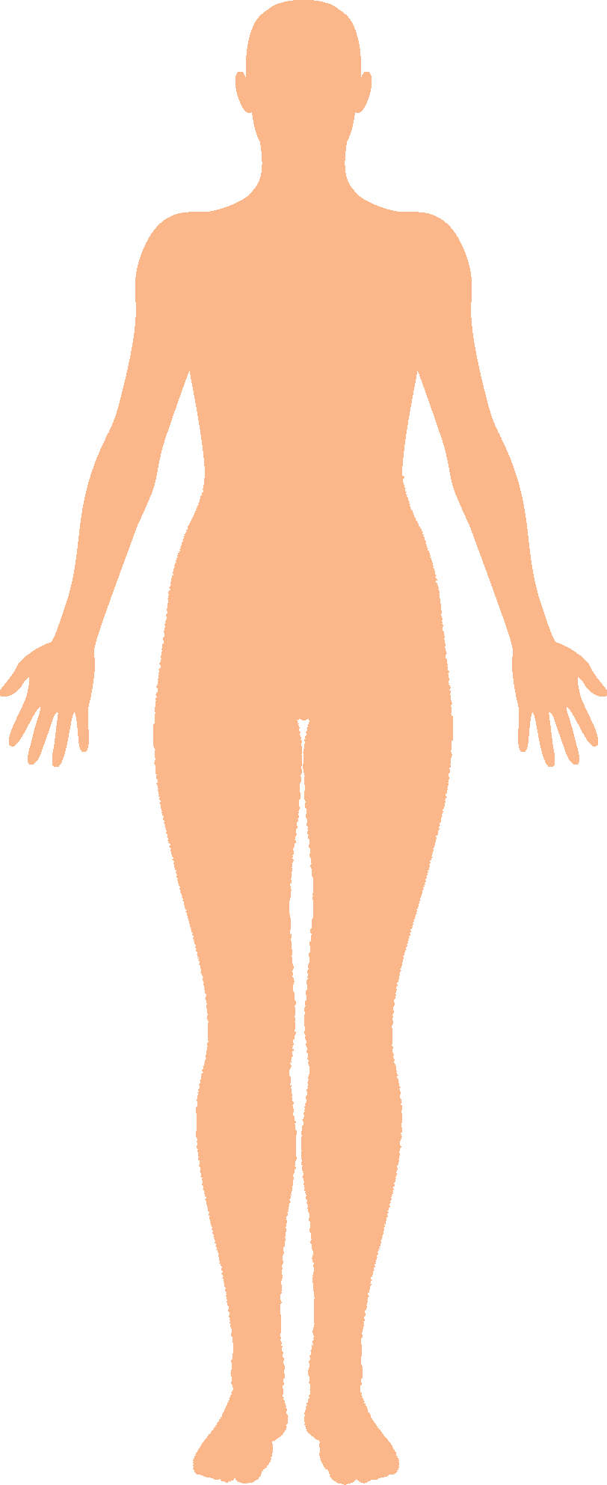
The circulatory system
A system is an organisation of different organs arranged so that, together, they can perform complex functions for the body.
?
Which systems of the body do you already know?
What do they do?
the human body

Slide 4
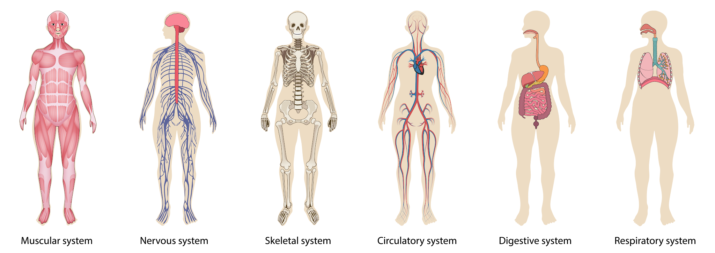
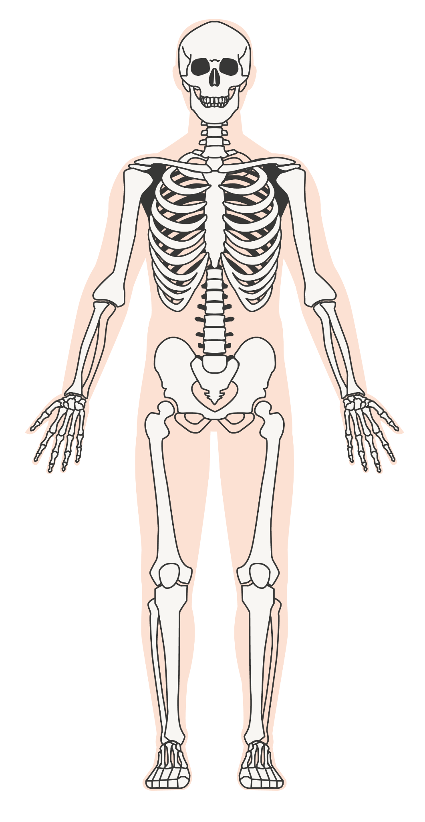
The circulatory system
Different systems in the body include:
the skeletal system
the digestive system
the muscular system

Slide 5



The circulatory system
What do you know about the skeletal, digestive and muscular systems?
The skeletal system is your body’s support structure, giving it shape and allowing movement. It also protects the organs.
The digestive system breaks the food we eat up and transfers water and nutrients into the bloodstream.
The muscular system is responsible for all movement. Muscles are attached to bones, organs and blood vessels.
Aisha
Andeep
Laura

Slide 6
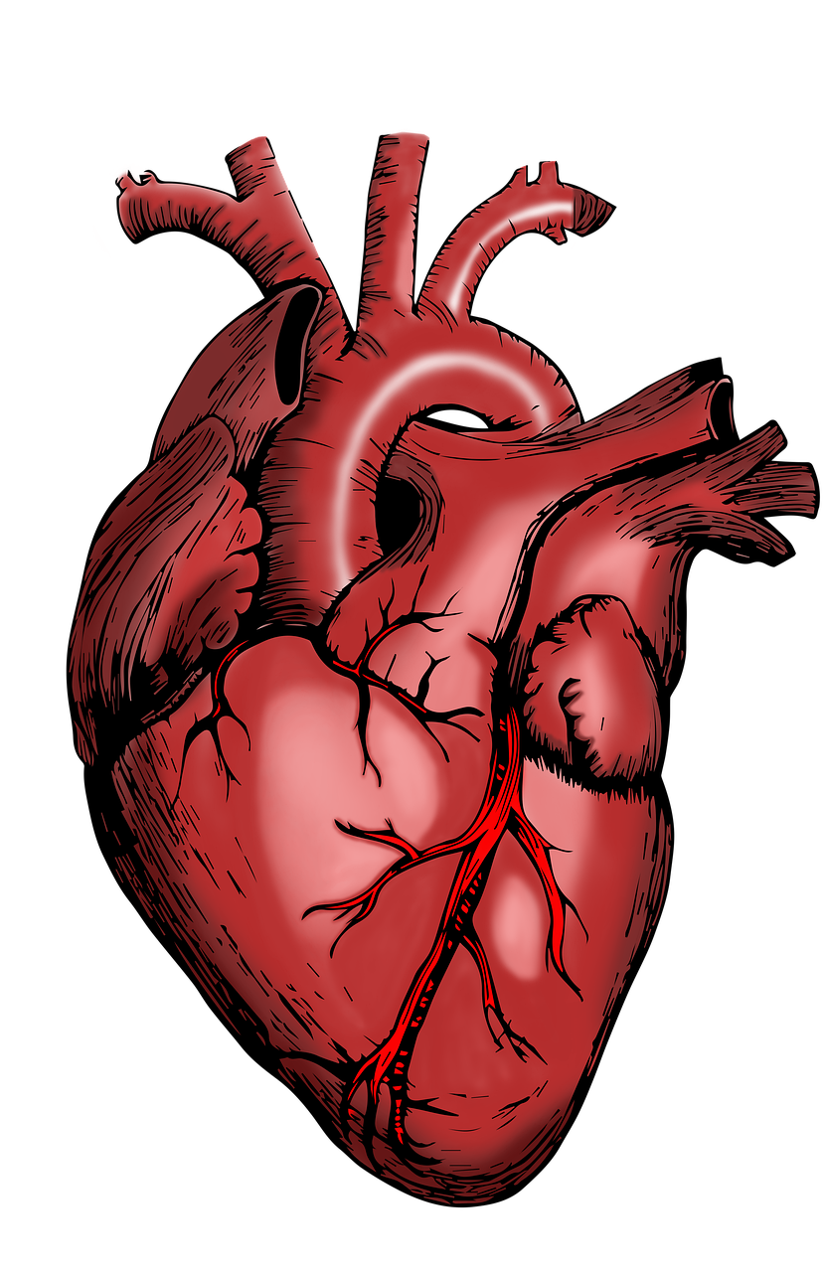
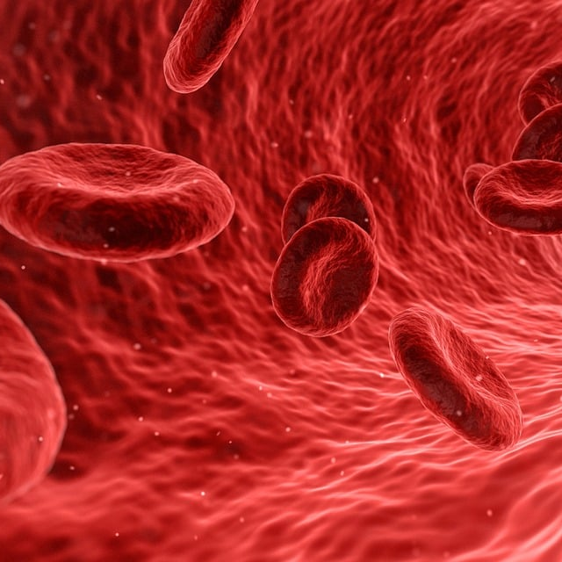
The circulatory system
Another system in the human body is called the
circulatory system. It consists of three important components.
What three body parts make up the circulatory system?
heart
blood
blood vessels

Slide 7
The circulatory system
The circulatory system consists of the heart, blood and blood vessels.
The heart pumps blood through blood vessels.
They all work together to ensure that blood circulates around the body, performing its important functions.
circulatory system

Slide 8

The circulatory system
Which three body parts make up the human circulatory system?
stomach, blood, blood vessels
lungs, blood, heart
blood, heart, blood vessels

Slide 9
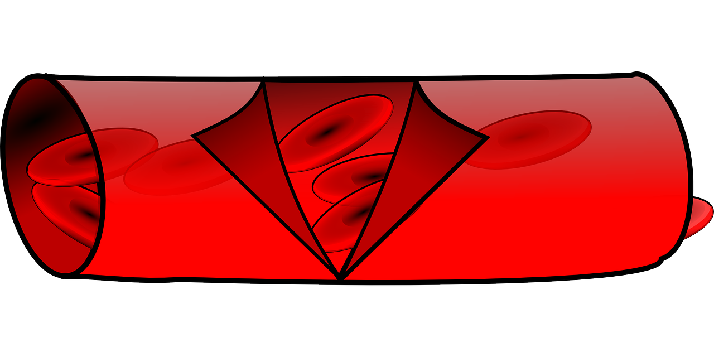
The circulatory system
The circulatory system is responsible for the flow of blood through the heart and around the body through tubes called blood vessels.
What does blood carry to all parts of the body?
drawing of a blood vessel
What does blood carry back from the body to be removed?
Sofia

Slide 10
The circulatory system
The blood …
… removes waste products that it doesn’t need, like carbon dioxide.
… supplies the body with nutrients and oxygen.
Andeep
Aisha

Slide 11
The circulatory system
If blood transports oxygen, why are the lungs not a part of the circulatory system?
Laura
What do you think?
circulatory system

Slide 12
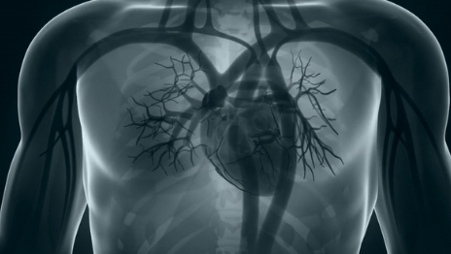
The circulatory system
The lungs are part of another system in the human
body called the respiratory (breathing) system.
The circulatory system supports the respiratory system by bringing blood to and from the lungs.
At the lungs, blood picks up oxygen and drops off carbon dioxide.
Blood vessels stretch their way to the lungs to absorb oxygen.

Slide 13
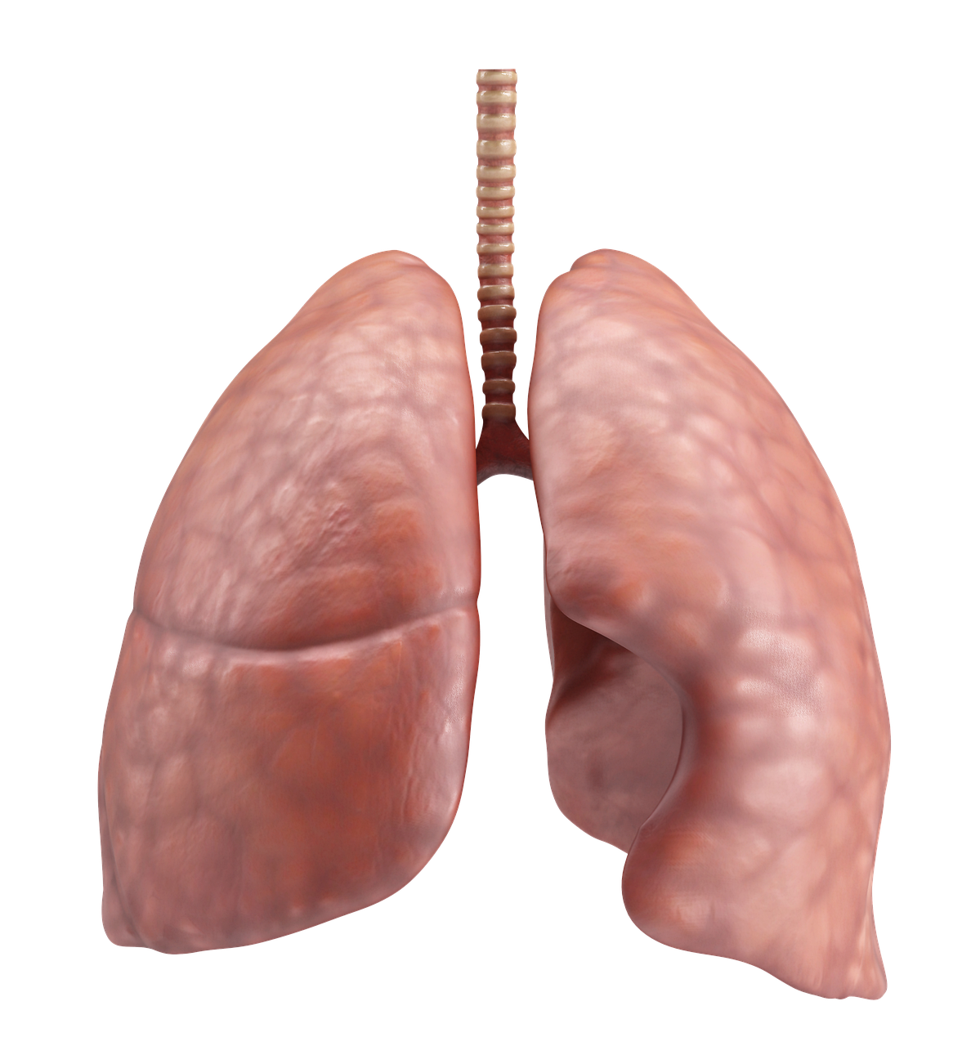
The circulatory system
Blood carries carbon dioxide to the lungs to be exhaled.
Blood collects oxygen from the lungs.
lungs
Veins transport blood that has collected carbon dioxide from the body back to the heart
Arteries transport this oxygen rich blood from the heart to every part of the body.
heart
body

Slide 14
The circulatory system
The lungs are a part of the circulatory system.
The lungs are a part of the respiratory system which supplies oxygen to the circulatory system.
The lungs pump oxygen into the heart through tubes.

Slide 15
The circulatory system
The circulatory system removes waste.
The circulatory system supplies the body with nutrients and oxygen and removes waste.
The circulatory system is responsible for getting rid of our waste food.

Slide 16
The circulatory system
Make a matching card game to help you to identify and name each part of the circulatory system.
name | diagram | function
heart
Cut out the cards, shuffle them and challenge each other to match them up.

Slide 17

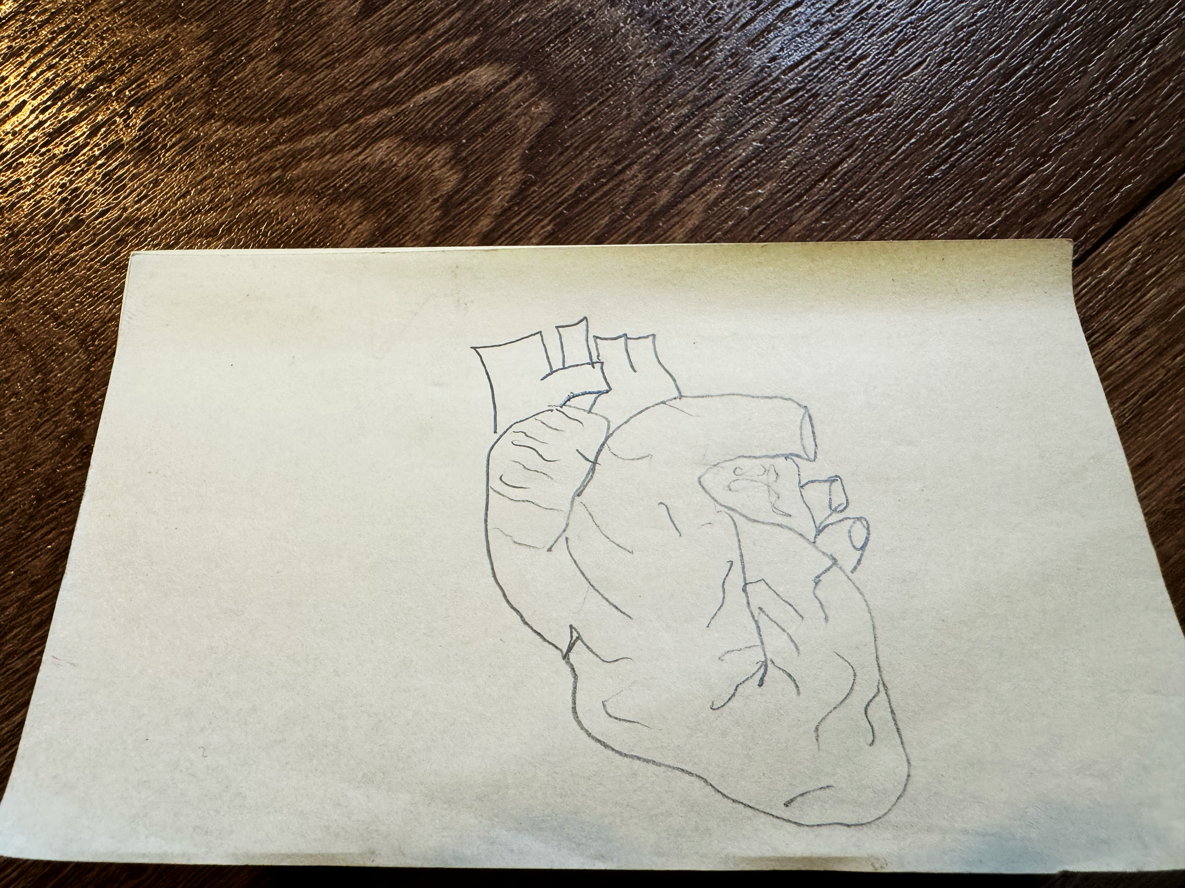
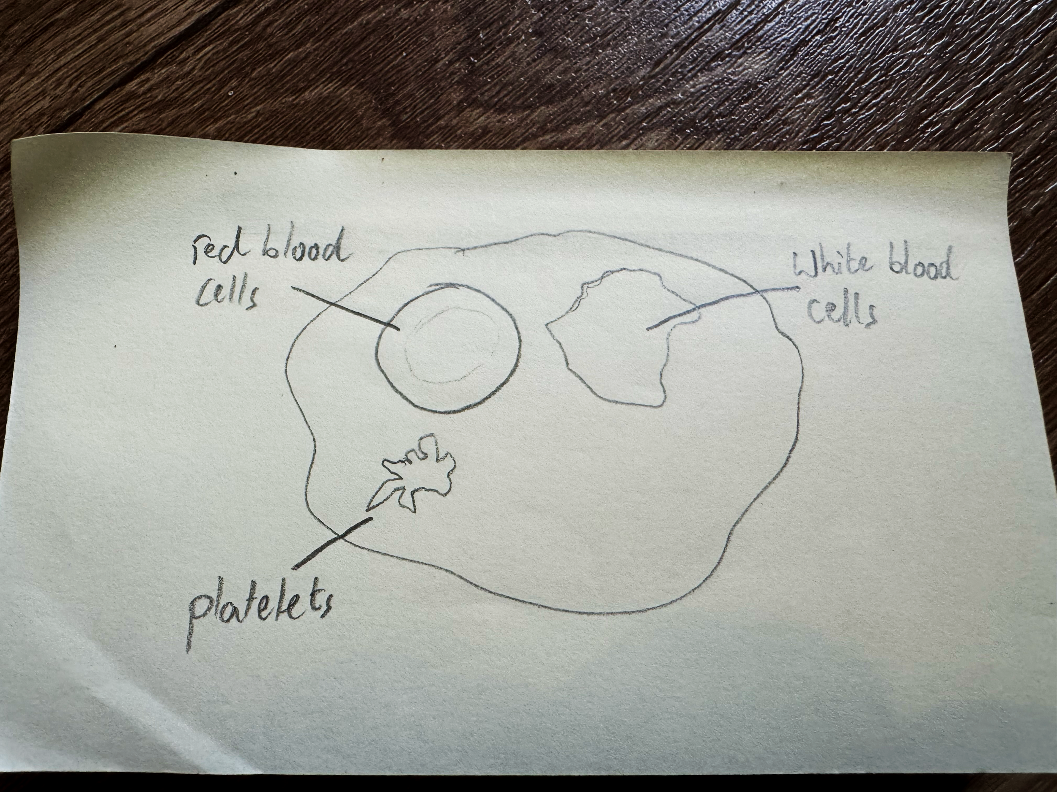
The circulatory system
Make a matching card game to help you to identify and name each part of the circulatory system.
Your cards may be similar to Jacob’s:
Pumps blood around the body by relaxing and contracting.
Jacob
heart
Transports oxygen, nutrients and waste products.
blood

Slide 18
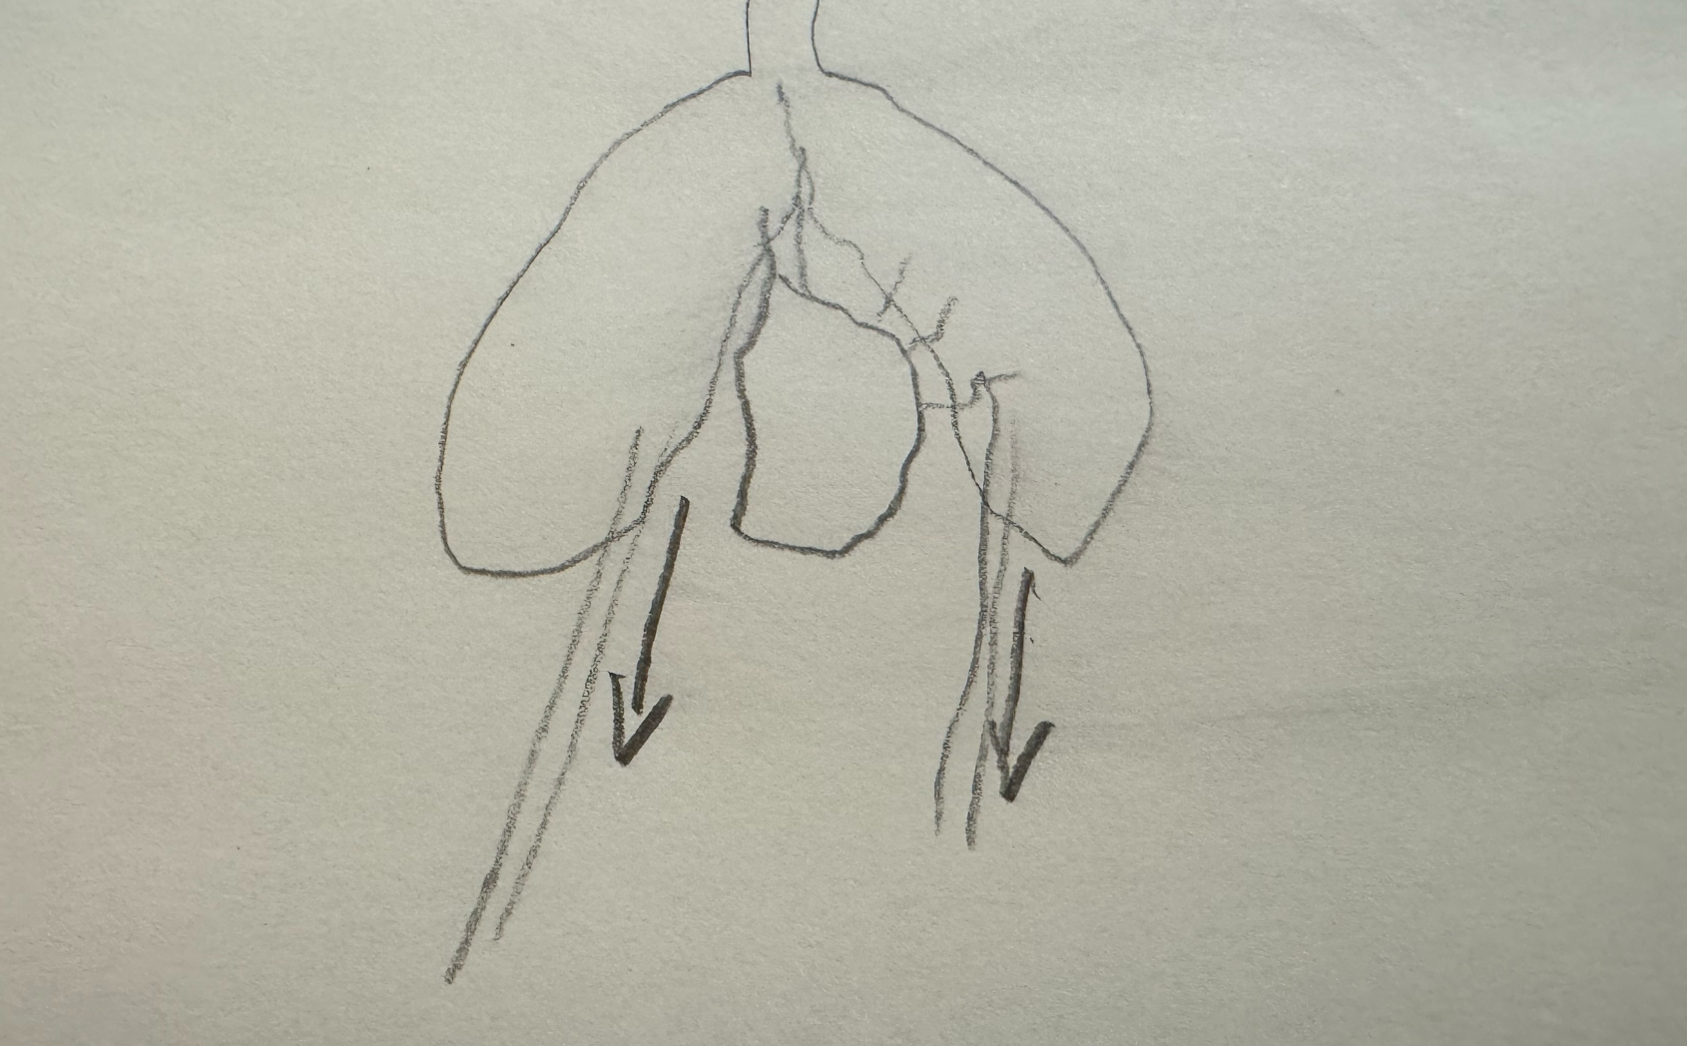
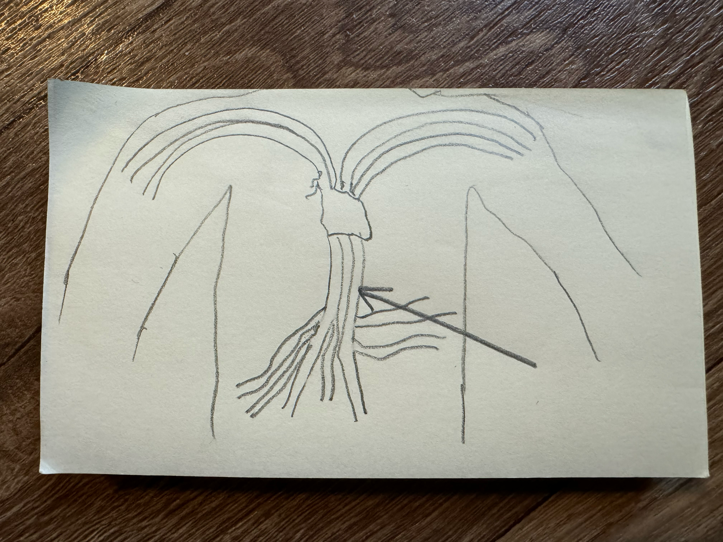

The circulatory system
Transports oxygen rich blood around the body.
arteries
Jacob
Tubes through which blood flows around the body.
blood vessels
Transports blood low in oxygen back to the heart.
veins

Slide 19
The circulatory system in humans
The circulatory system consists of the heart, blood vessels and blood working together in the human body.
The circulatory system supplies the body with nutrients and oxygen and removes waste products that it doesn’t need.
A flowchart is a diagram using boxes, lines and arrows that shows the steps of a process from beginning to end.
Writing a draft plan gives you an opportunity to find ways of improving your work.

