Slide 1


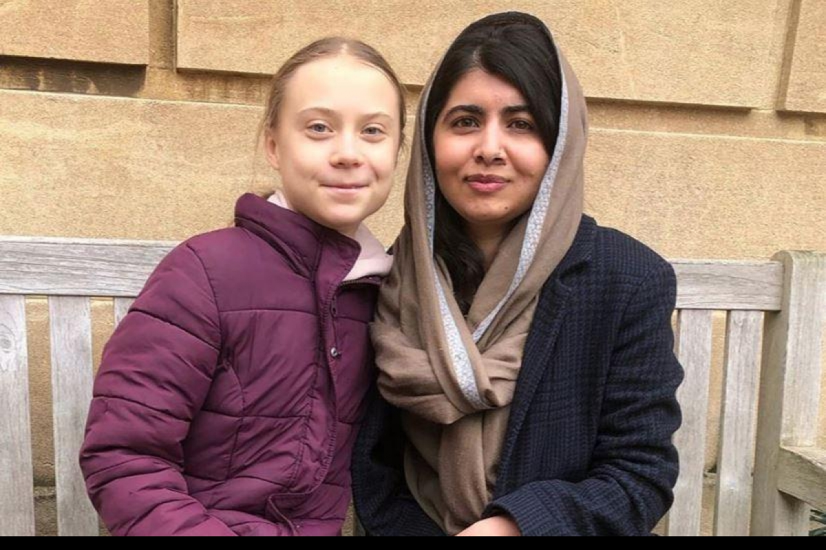


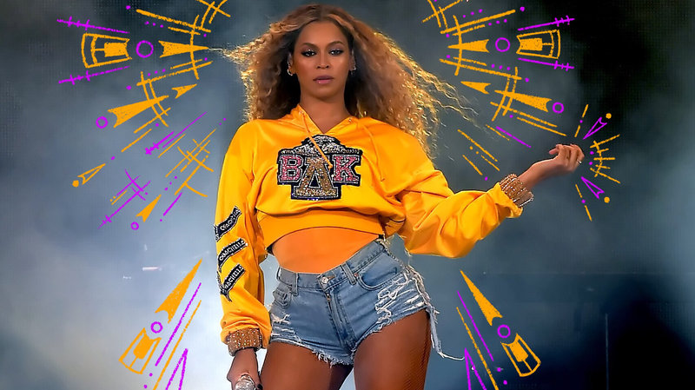
ASPIRATIONS

Slide 2

What is the difference between inspiration and aspiration?
Inspiration inspires you to do something.
For example: I feel inspired to save the planet.
Aspiration is the goal you want to achieve.
For example: I aspire to work for a technology company that works on using renewable energy.

Slide 3
Why is it good to have aspirations?
Goals motivate us to achieve something that is challenging for us to do.
Sometimes we are inspired by certain people and we aspire to be like them as we grow up.
Do you recognise any of the inspirational people in these pictures?
Simone Biles – world’s best gymnast.
Greta Thunberg and Malala Yousufzai – young activists
Beyonce – singer with the most Grammys
Ronaldo and Messi – highest paid footballers.
Bill Gates – founder of Microsoft

Slide 4


Remember everyone’s aspirations are different.
An aspirational goal, usually involves challenge. And what people find challenging is very different.
For example, someone who has suffered an injury might aspire to walk again. Or someone with anxiety might aspire to one day go to a concert or get on a plane.
This could feel just as challenging for someone else who aspires to go to university as we all have different life experiences.

Slide 5
What do you think these people have in common? How have they all achieved their aspirations?
Write 5 personal qualities you think they have in your book.
Simone Biles – world’s best gymnast.
Greta Thunberg and Malala Yousufzai – young activists
Beyonce – singer with the most Grammys
Ronaldo and Messi – highest paid footballers.
Bill Gates – founder of Microsoft

Slide 6

Your aspirations…
Finish off these sentences with 4 of your aspirations.
By the end of year 6, I aspire to … (For example: have read 10 more books)
By the end of 2026, I aspire to… (For example: have made 5 new friends at secondary school)
By the time I am 18, I aspire to… (For example: have got into university)
By the time I am 40, I aspire to… (For example: be a well-established business person)

Slide 7
ASPIRATIONS
WHAT IS THE LINK BETWEEN INSPIRATION AND ASPIRATION?
WHY IS IT IMPORTANT TO HAVE ASPIRATIONS?
ARE ALL ACHIEVEMENTS BIG?
SHOULD WE BE REWARDED FOR EVERYTHING WE ACHIEVE?

