Slide 1
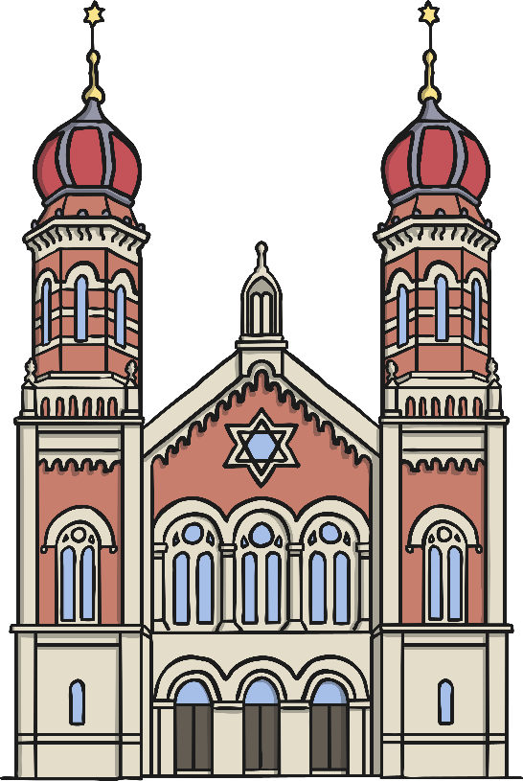
Places of Worship

Slide 2
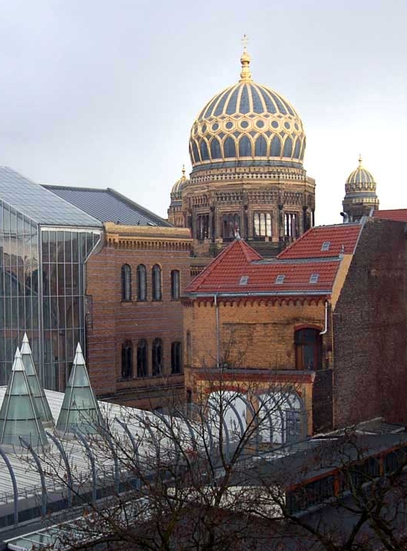
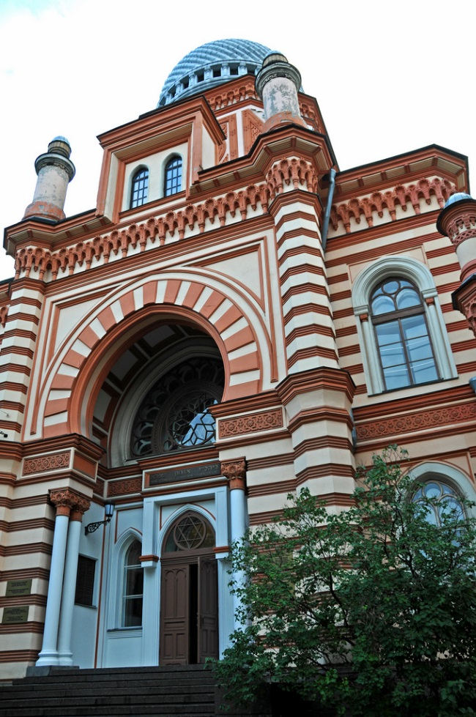
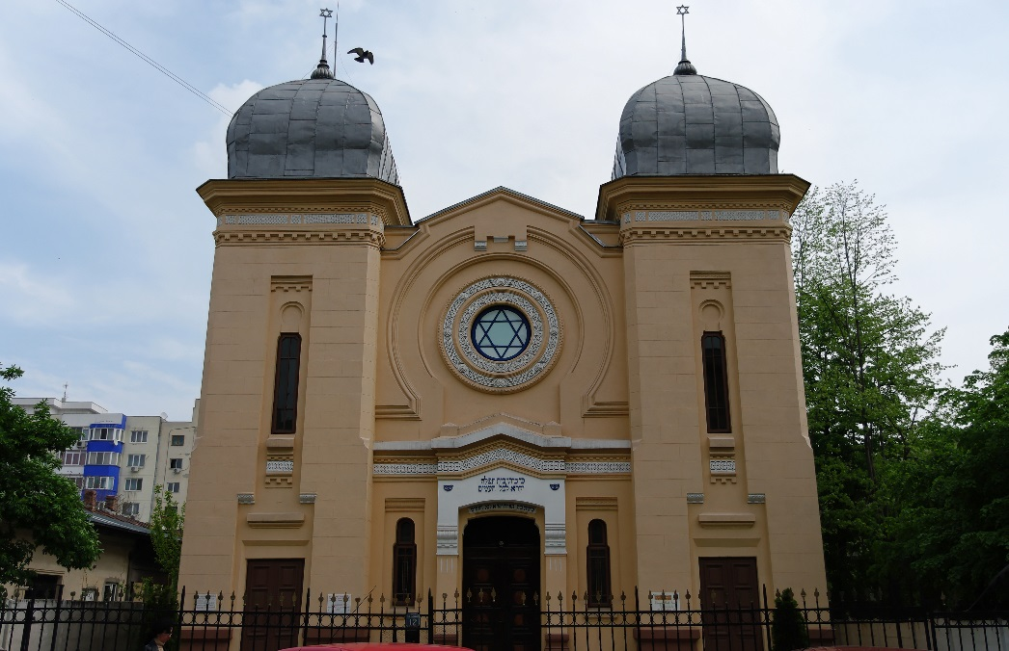
The Jewish place of worship is the Synagogue. Synagogues might look very different, but what do they all have many things in common.
Let’s find out more about what happens there.
Photos courtesy of budgetplaces.com, archer10 (Dennis) and emmanual Dyan (@flickr.com) - granted under creative commons licence - attribution

Slide 3
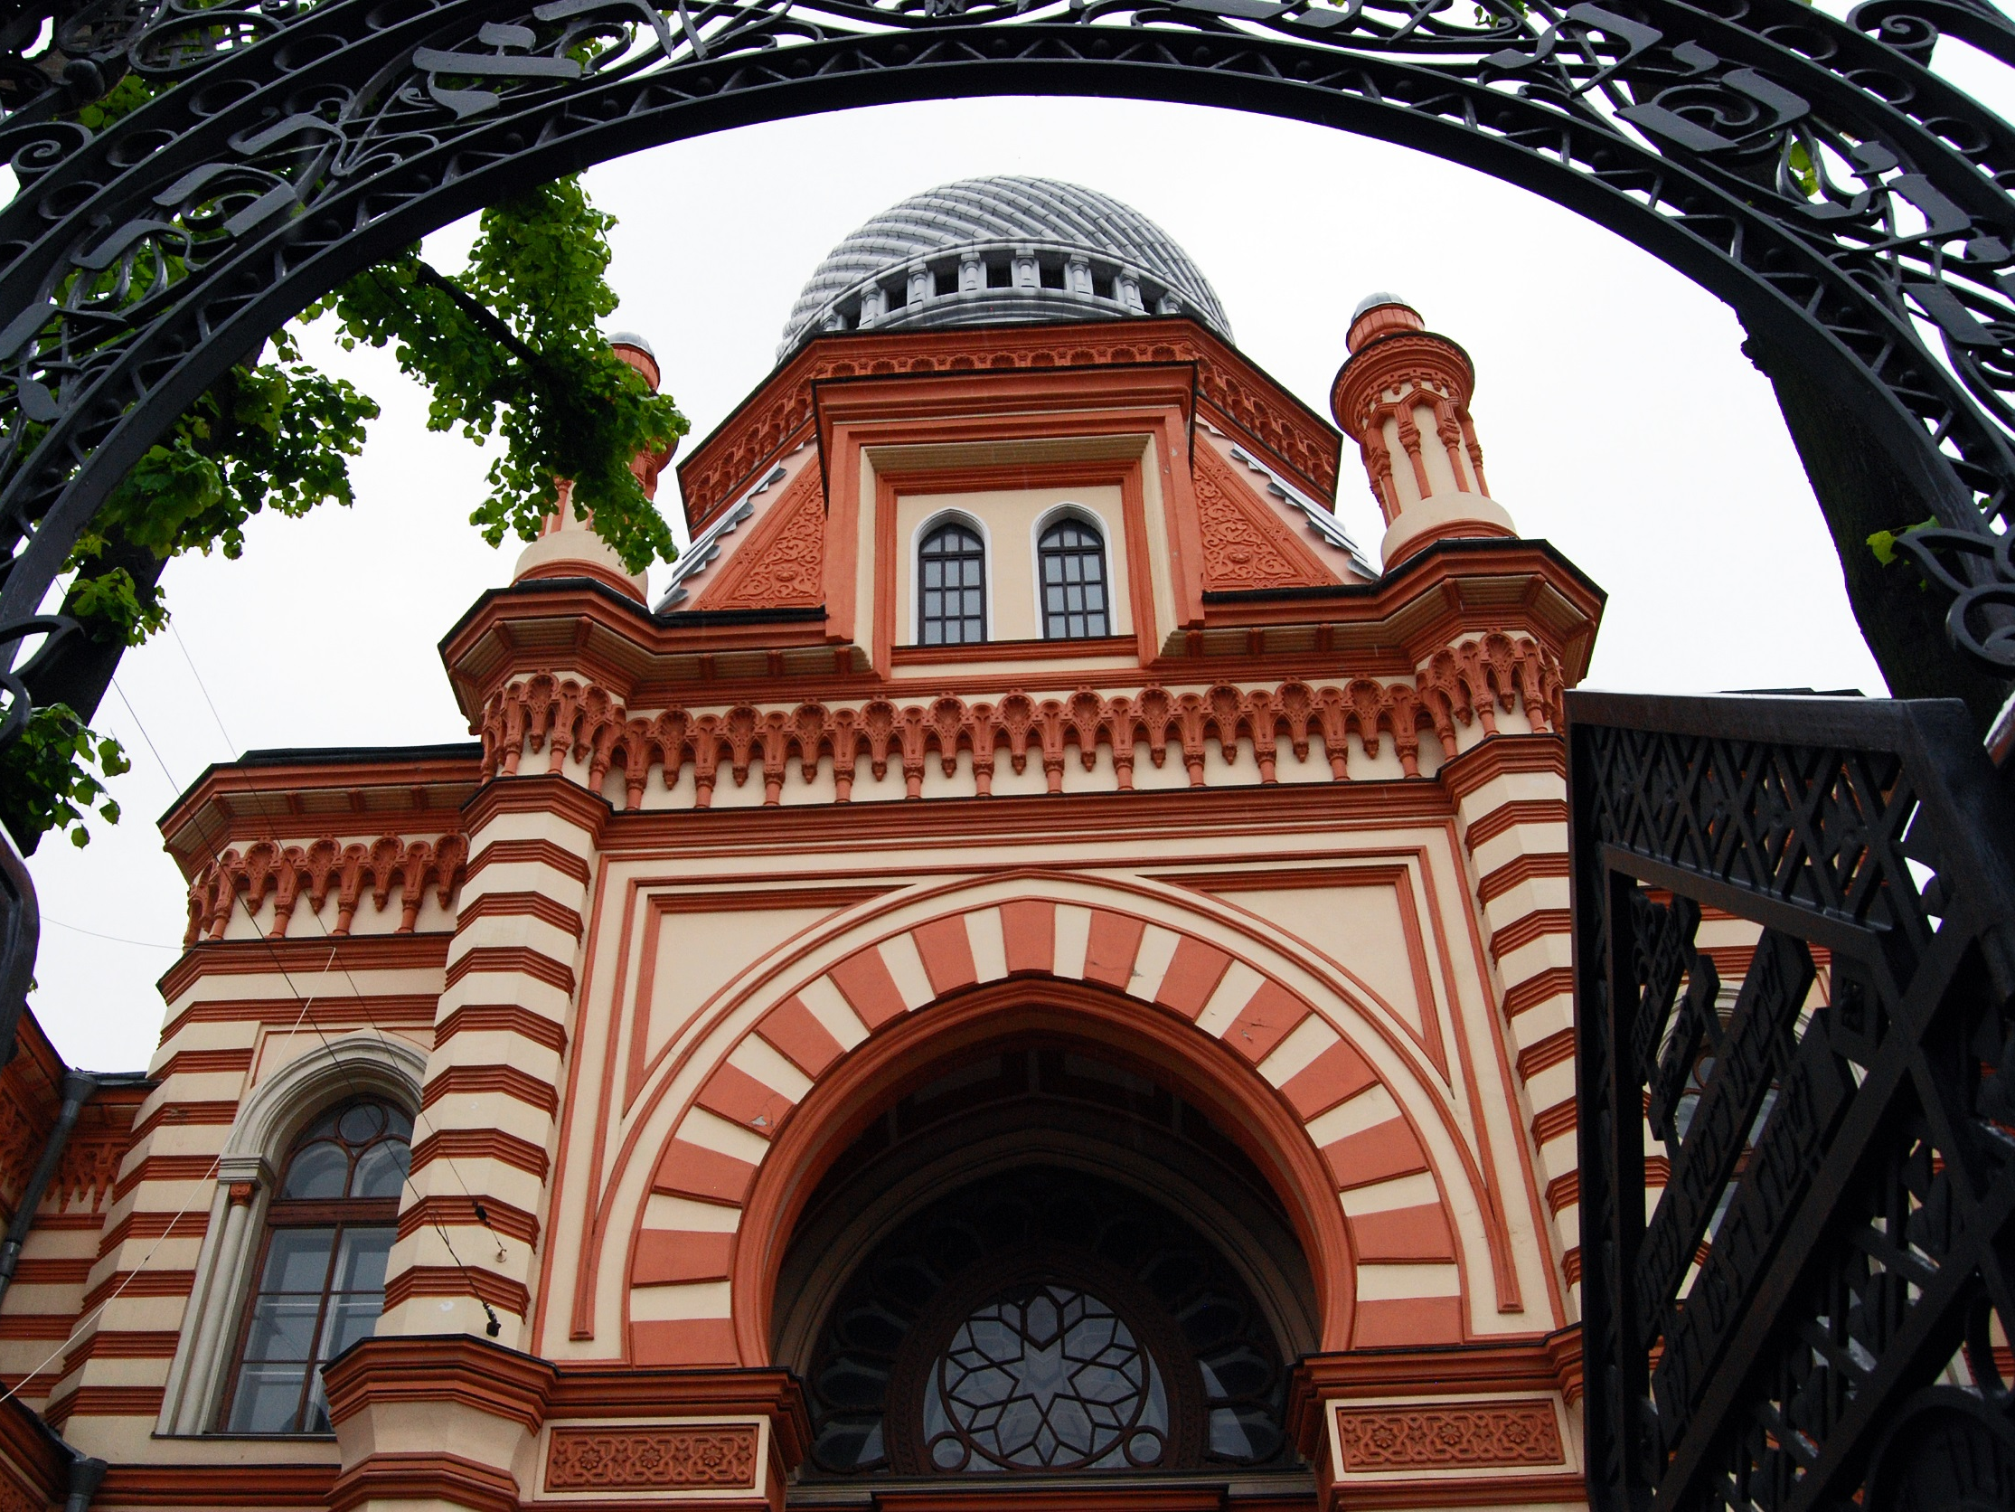
Jewish Synagogues Around the World
Grand Choral Synagogue, St Petersburg, Russia
Photos courtesy of HBarrison(@flickr.com) - granted under creative commons licence - attribution

Slide 4
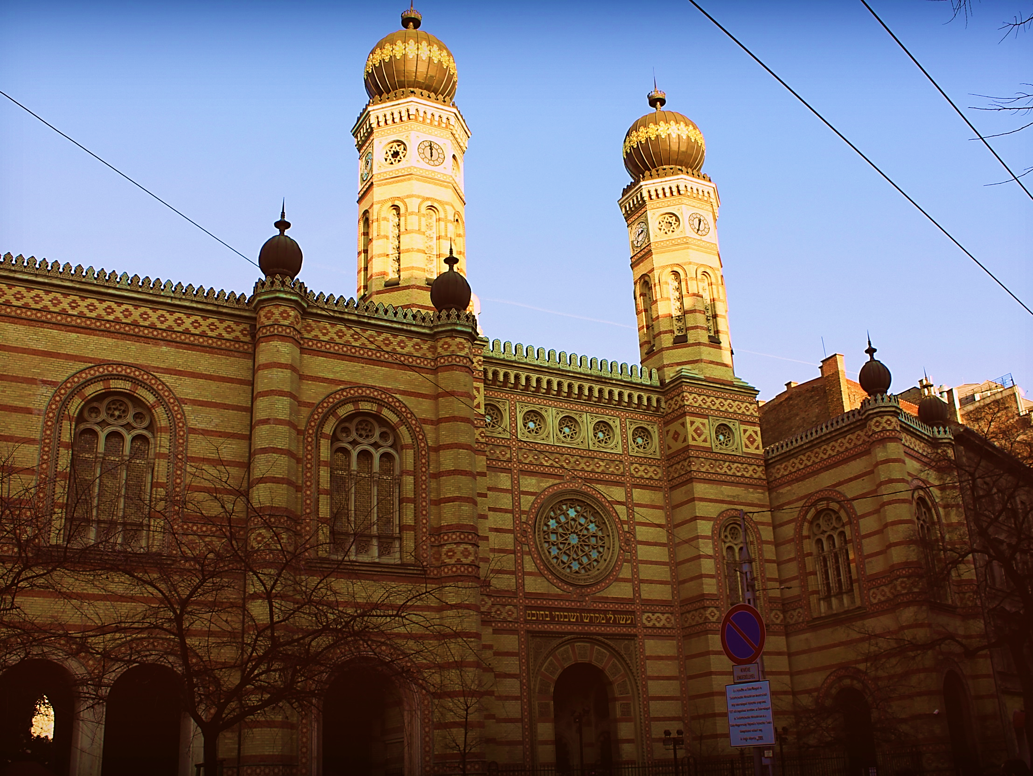
Dohany Street Synagogue, Budapest
Photos courtesy of rachel_titiriga (@flickr.com) - granted under creative commons licence - attribution

Slide 5
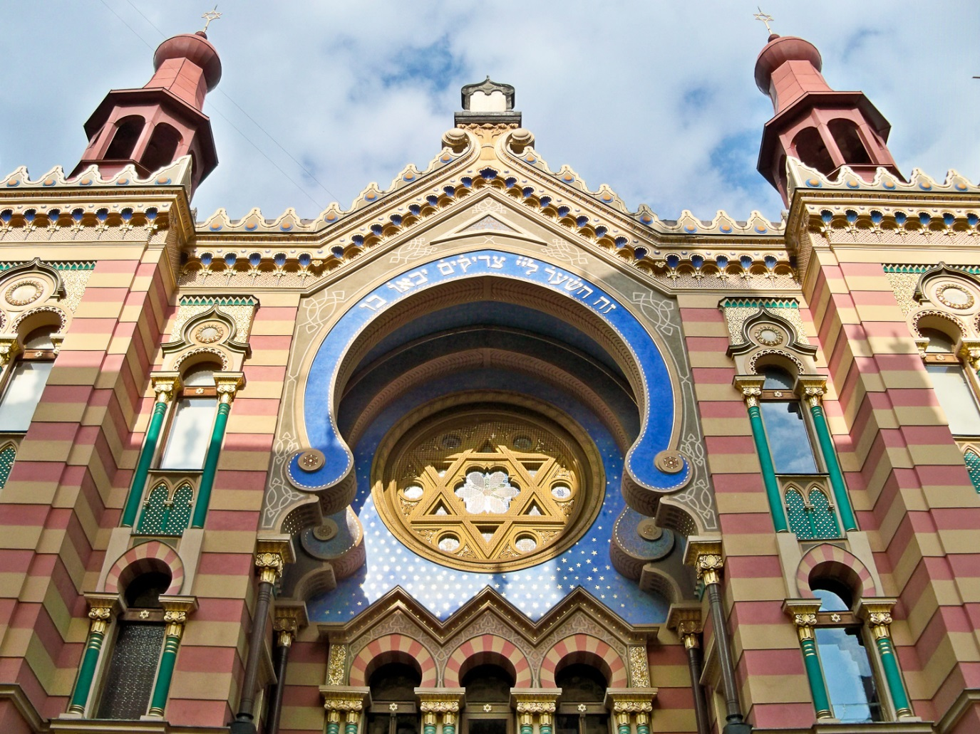
Jubilee Synagogue, Prague
Photos courtesy of cb_agulto (@flickr.com) - granted under creative commons licence - attribution

Slide 6
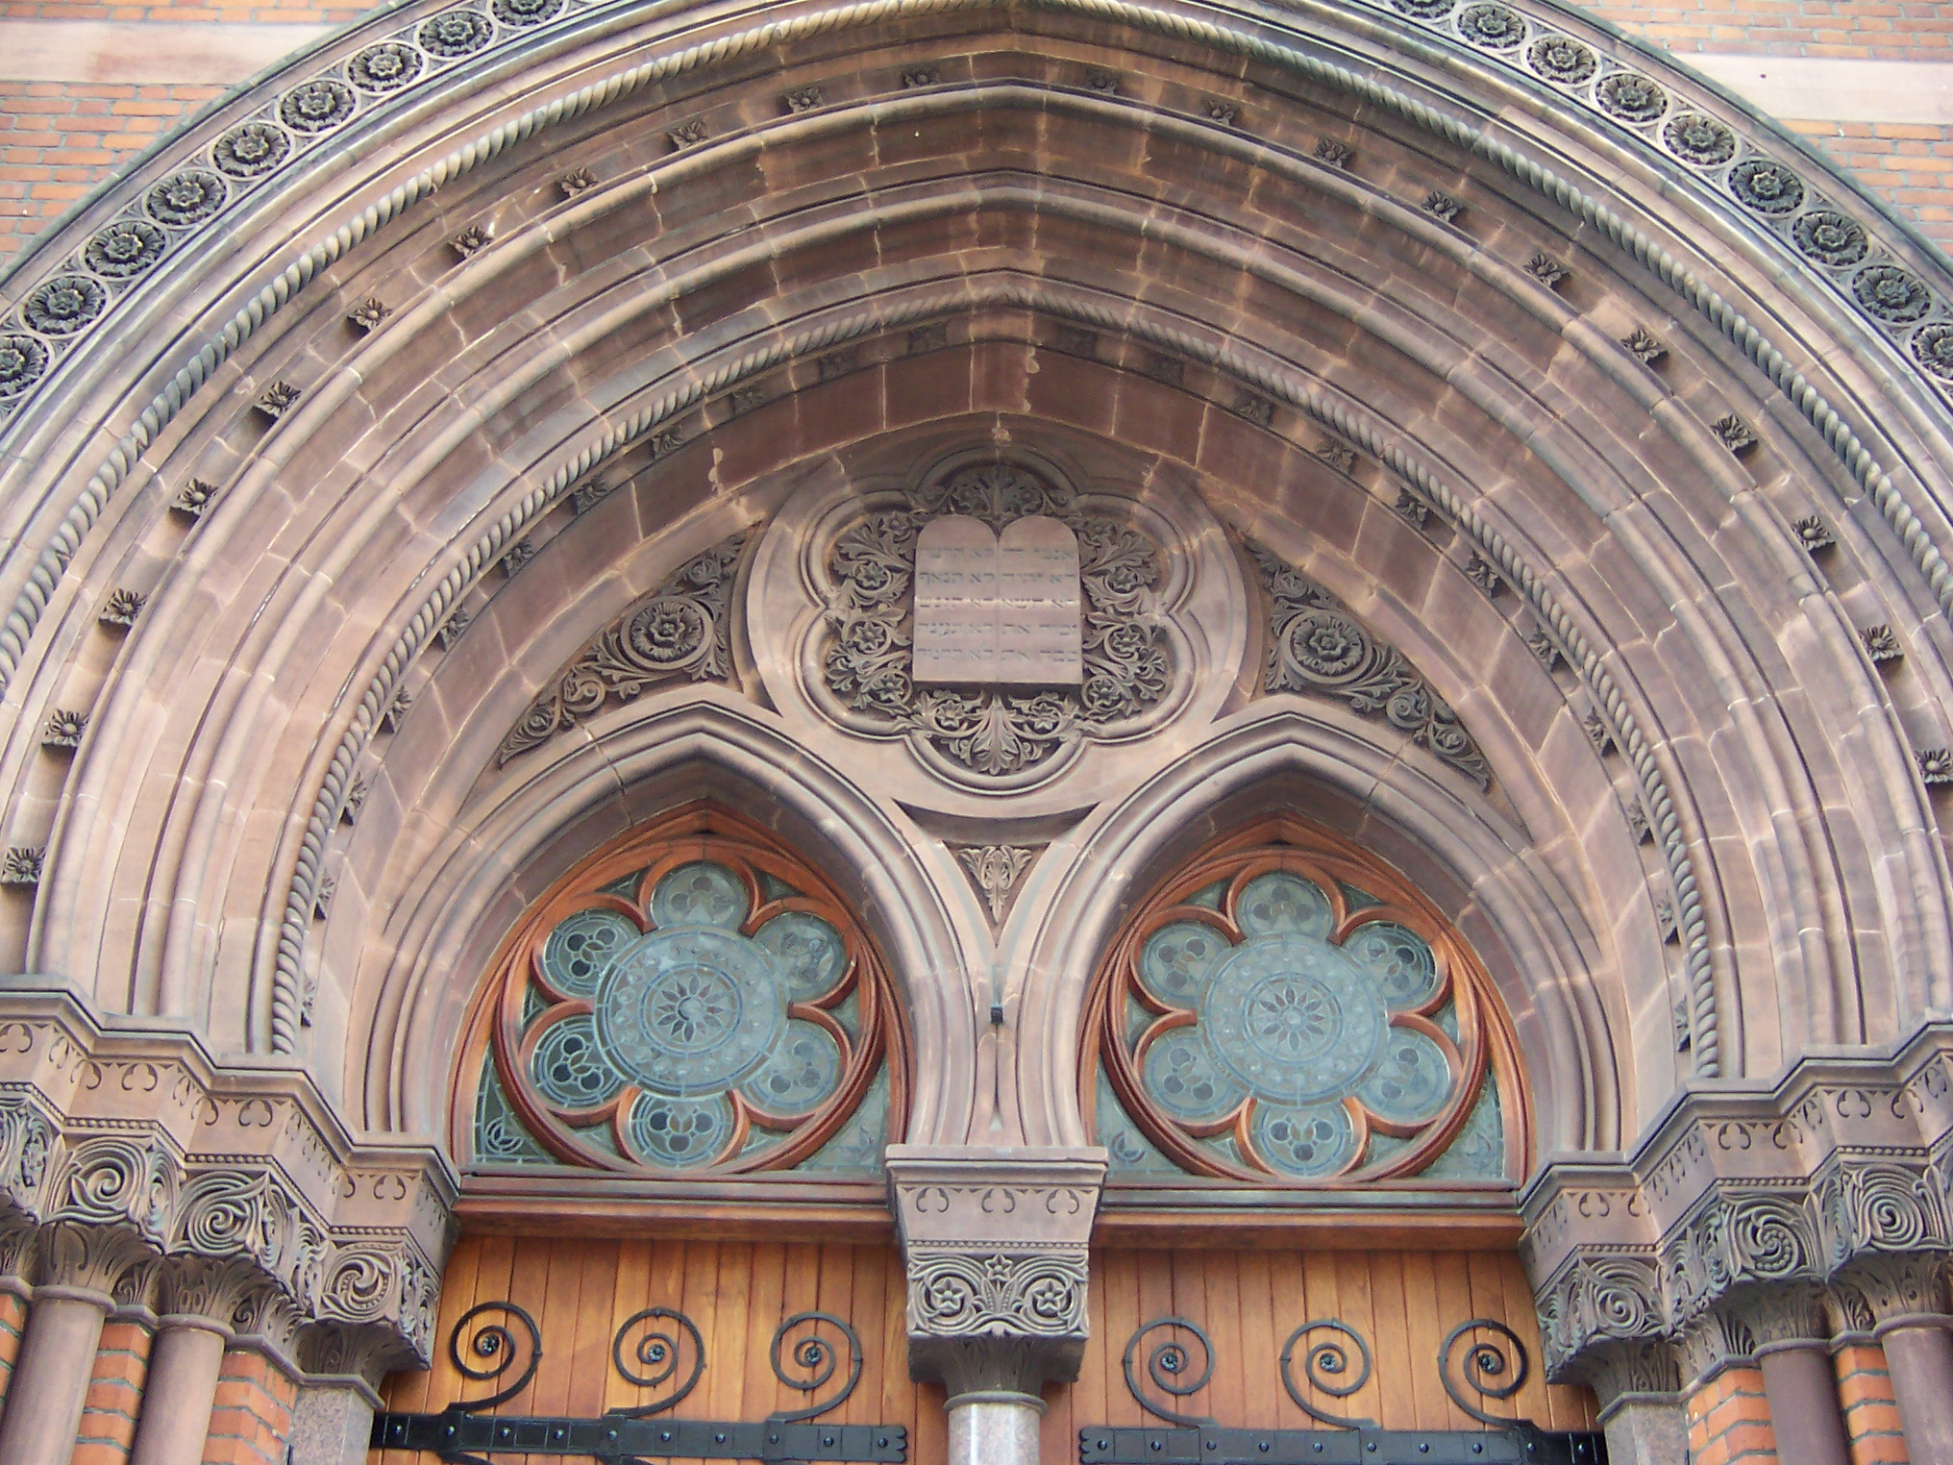
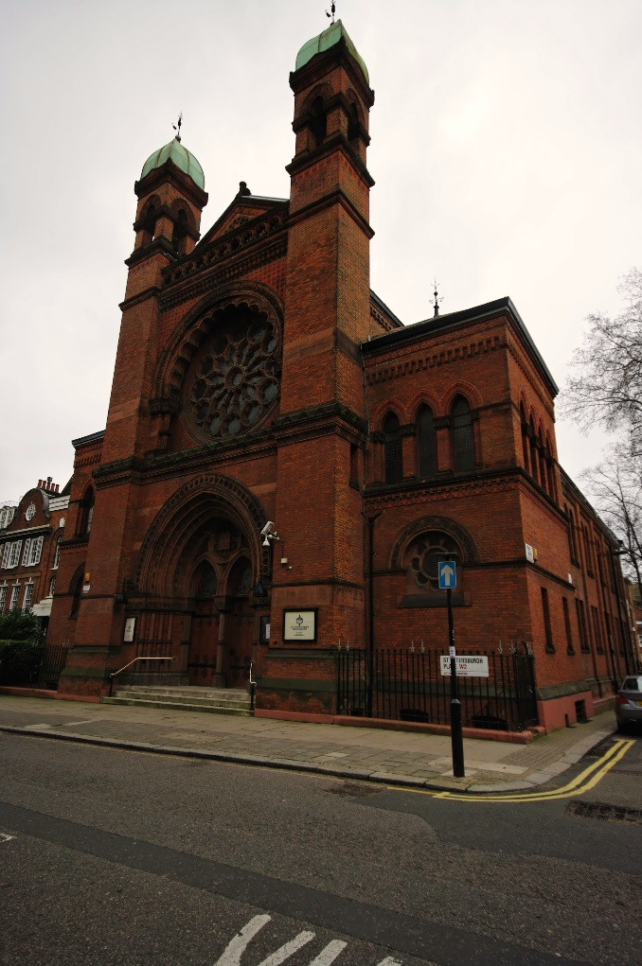
New West End Synagogue, London
Photos courtesy of Loz Flowers(@flickr.com) - granted under creative commons licence - attribution

Slide 7
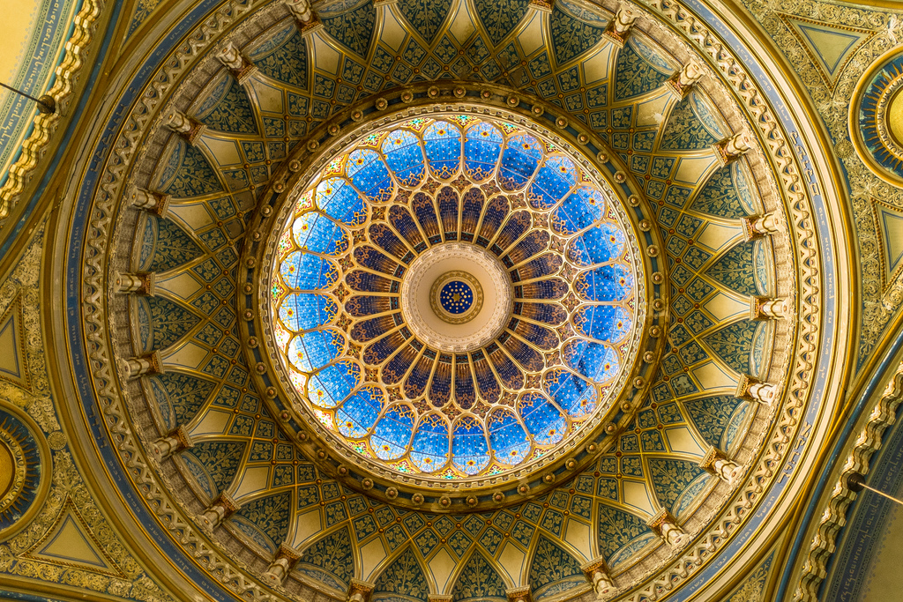
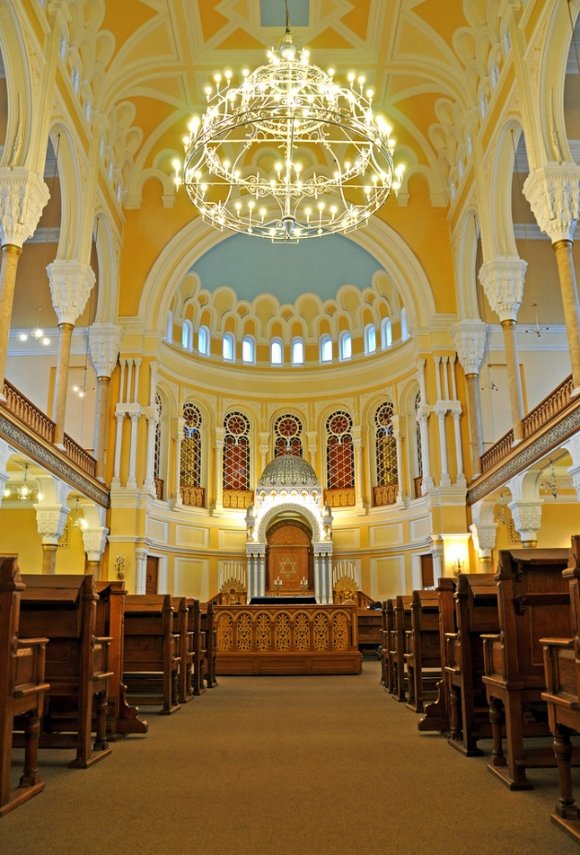
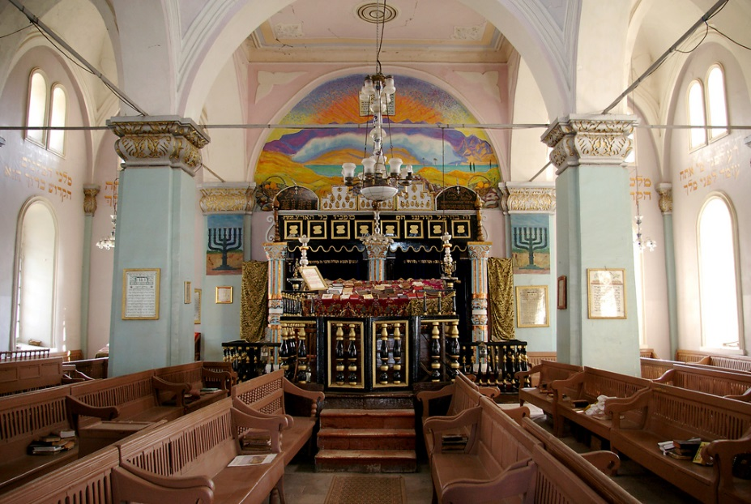
What is it like inside a Jewish Synagogue?
Photos courtesy of archer10 (Dennis), SusanAstray and Sine Pi(@flickr.com) - granted under creative commons licence - attribution

Slide 8

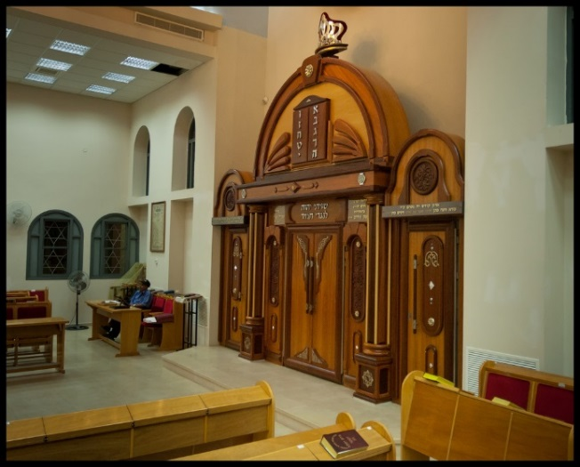

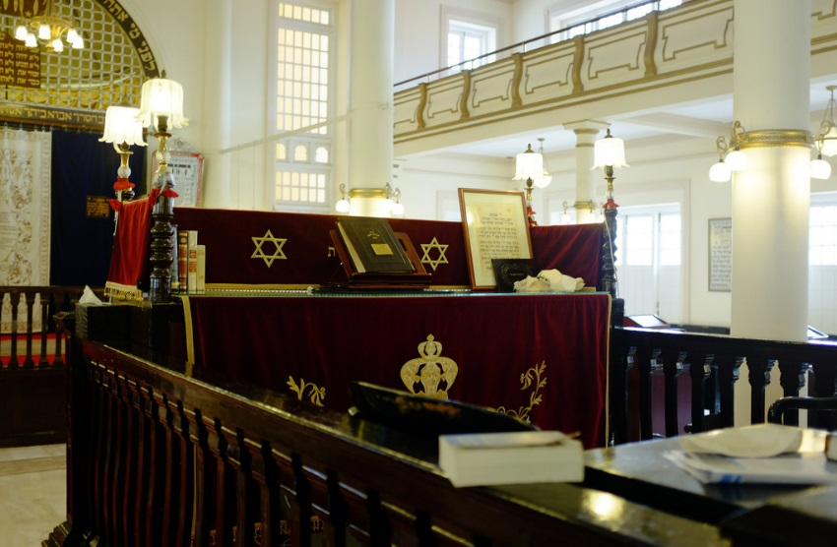
Ark
The Ark is a cupboard in which the Torah scrolls are kept.
Siddur
This is the main prayer book.
Important
Features of a
Jewish
Synagogue
Bimah
A raised platform where most of the service takes place. The Torah readings happen here.
Photos courtesy of Flavio~ (@flickr.com) - granted under creative commons licence - attribution

Slide 9
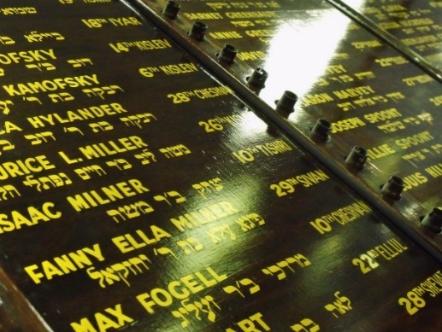

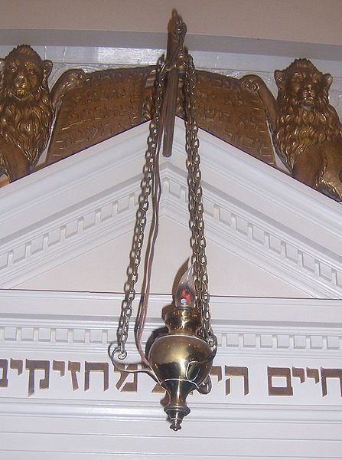
Torah Scrolls
The scrolls contain the words of the Hebrew Bible.
Memorial Boards
These are boards full of name plates. Each name plate remembers someone who has died.
Important
Features of a
Jewish
Synagogue
The Eternal Light
This hangs above the Ark and is always burning to remind everyone that God is always with them.
Photo courtesy of GlasgowAmateur (@flickr.com) - granted under creative commons licence - attribution

Slide 10
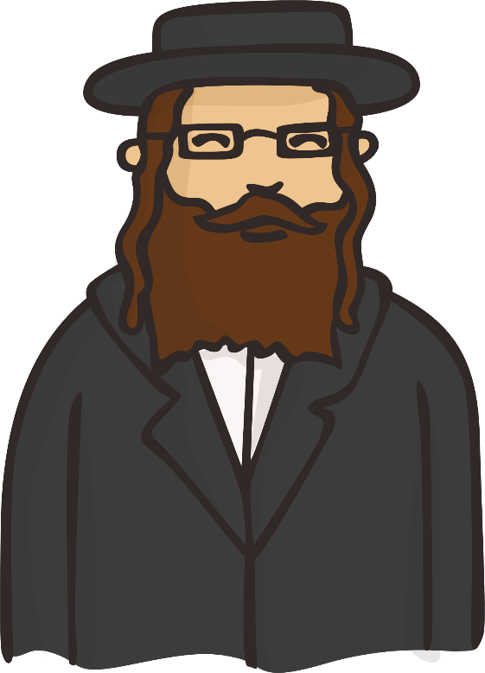
Why do people go to a Jewish Synagogue?
People go to the synagogue to worship but also to study. Many synagogues are also community centres where local Jewish people can meet and take part in different activities and events.
A synagogue is a house of prayer where Jewish people can get together to feel closer to God, and each other.
The services are led by a rabbi or a worshipper.

Slide 11
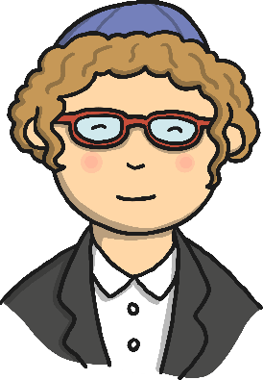
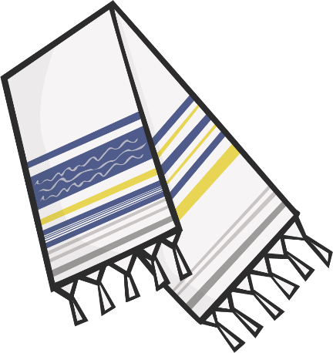
Showing Respect
During the service everyone, except women who aren’t married, must wear a hat to show respect to God; this is called a kippah.
Adult men wear a prayer shawl for morning prayer which has fringes along the edge to remind the worshipper to follow God’s way.

